Slide 1
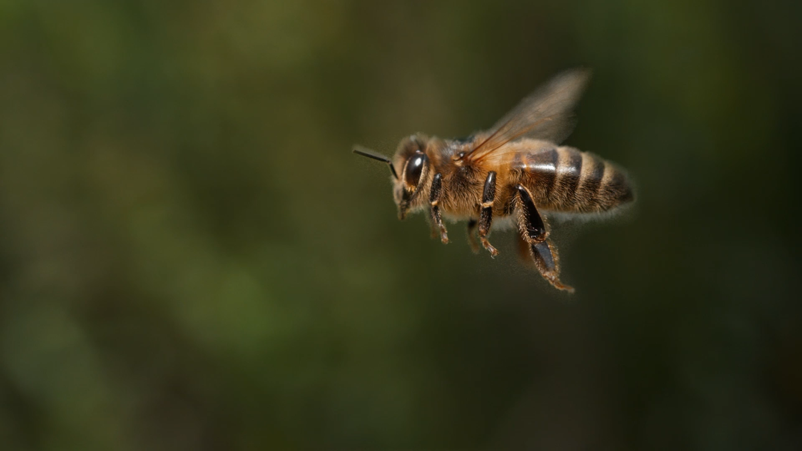
Honeybees’ Division of Labour
Distributed Artificial Intelligence
UNIMORE – 2024/2025
Andrea Grandi

Slide 2
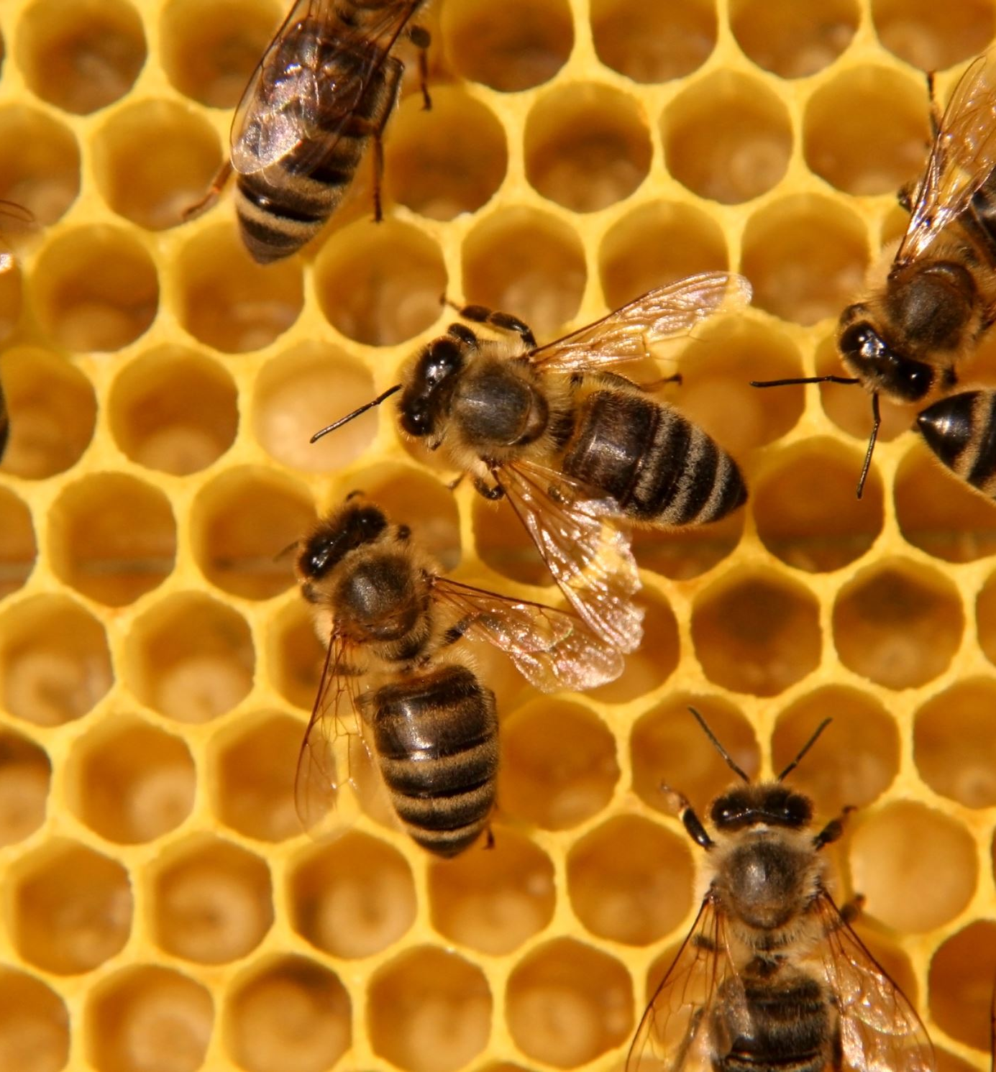
Idea
This work aims to describe and implement the Honeybees’ Division of Labour presented in the paper [1].
Used to build a swarm of autonomous agents that shows self-organization and emerging intelligence when interacting with each other in a common environment.
[1] Thomas, Schmickl & Karl, Crailsheim. (2008). Analysing honeybees’ division of labour in broodcare by a multi-agent model

Slide 3
This multi-agent model of a honeybee colony incorporates several important honeybee specific details:
1. A typical spatial distribution of brood and food in the hive.
2. Complex behavioural programs of specialized workers.
3. Characteristics of the spreading of different kinds of stimuli (chemicals, sounds/vibration, light).
4. Agents physiology (energetic expenditures).
5. Flow of nutrients among the agents and the combs.

Slide 4
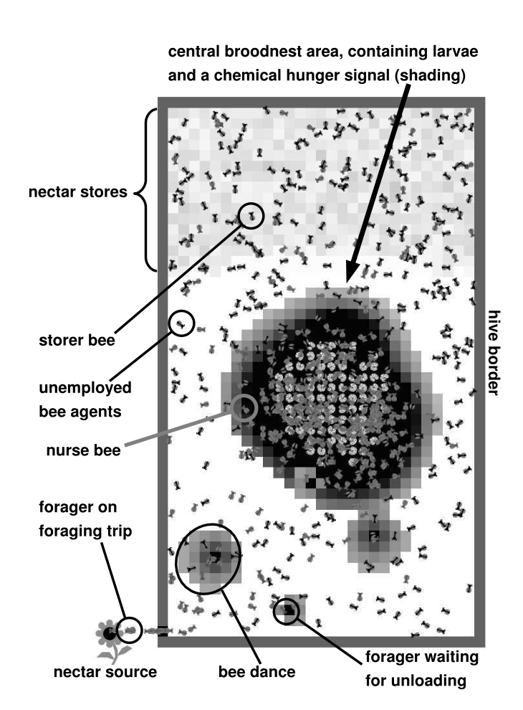
The Model
Agents: adult bees and larvae
Stimuli: dances, contact stimuli, chemical signals and light
Resource stores: necar (or honey)

Slide 5
Tasks
Unemployed bees: These bees move randomly in the hive and wait for stimuli to became a Forager, Storer or a Nourse bee.
Forager bees: These bees collects nectar from a nectar source (flower) outside of the hive.
Storer bees: These bees wait near the entrance for returning foragers
Nurse bees: These bees navigate (uphill) in the chemical stimulus emitted by hungry larvae.
Larvae: The brood resides in cells (patches) in the central broodnest area.

Slide 6
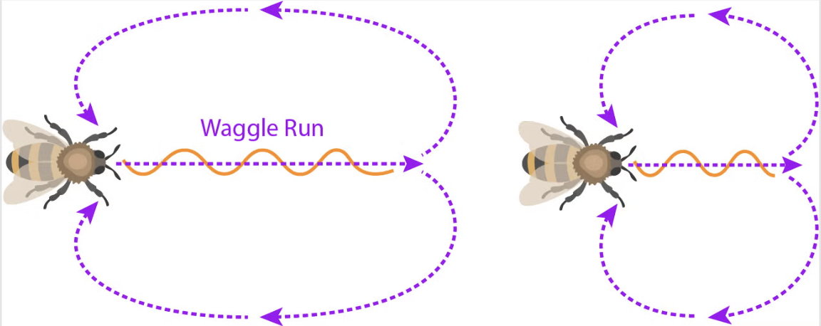
Stimuli
Contact stimuli:
Contact stimuli are emitted by returning forager bees to attract storer bees to take over the nectar load.
Depending on the waiting period a forager searched for a storer bee, it then performs either a ’waggle dance’ to recruit more forager bees or a ’tremble dance’ to recruit more storer bees.

Slide 7
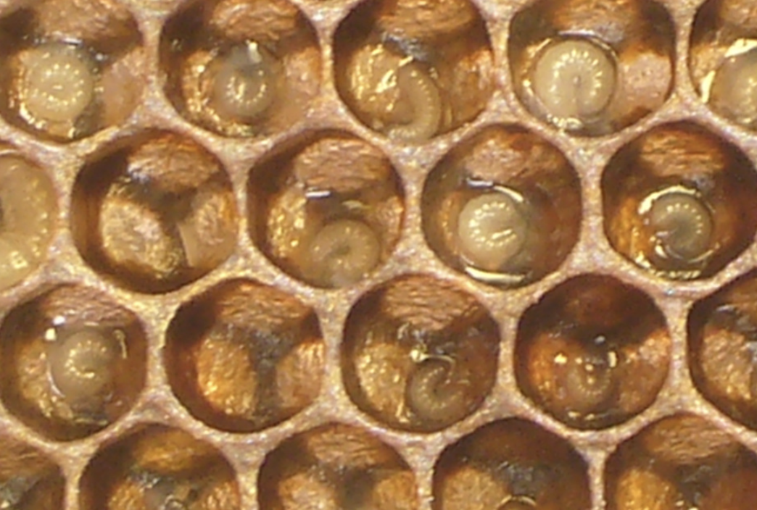
Chemical stimuli:
Chemical stimuli are emitted by larvae.
In case that a larva has a nectar reserve below the hunger threshold, it emit a hungry stimulus to alert the nurse bees.

Slide 8

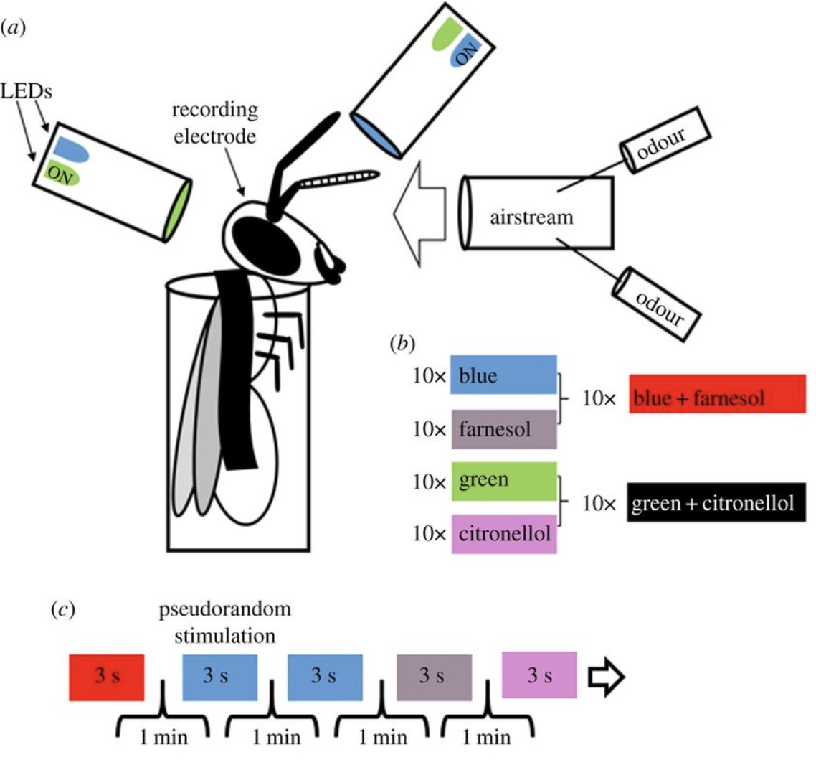
Light stimuli:
The light stimulus decreases linearly with increasing distance from the hive’s entrance and is used for navigation of foragers for leaving the hive and for navigation of storer bees for approaching the entrance area and for approaching the honey area.

Slide 9
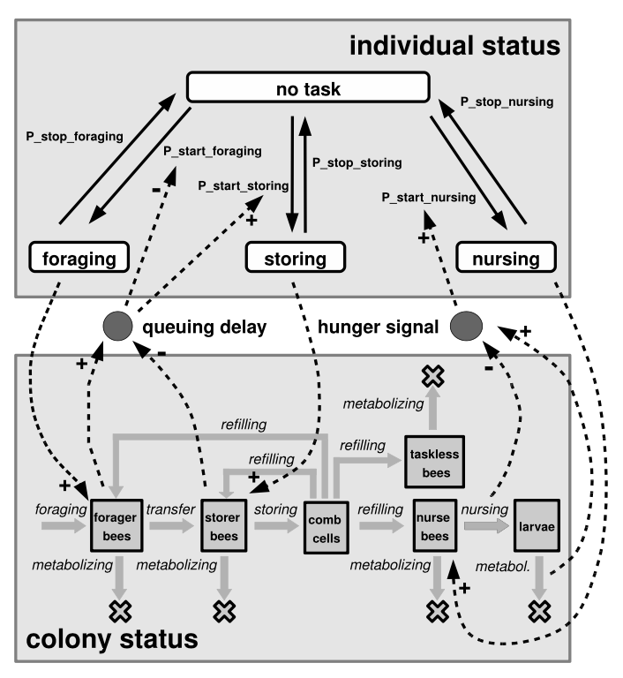
The flow of nectar, bees’ metabolism and task selection of agents

Slide 10
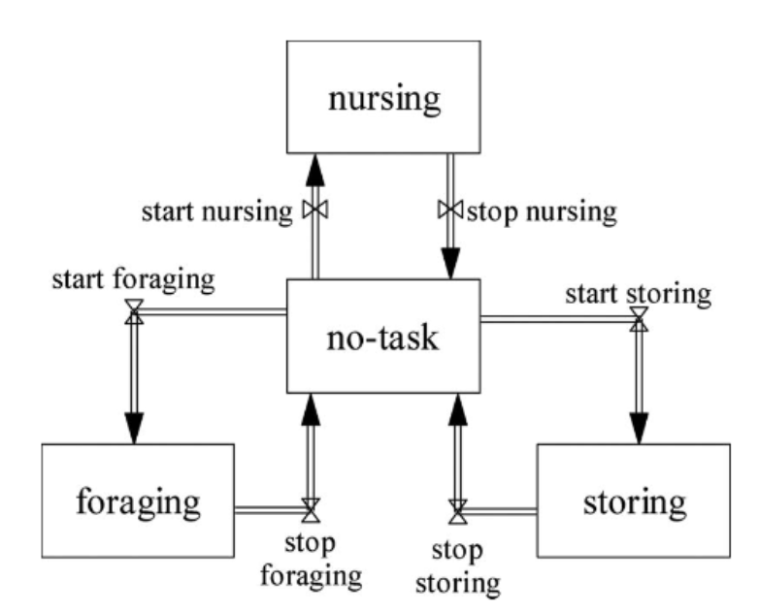
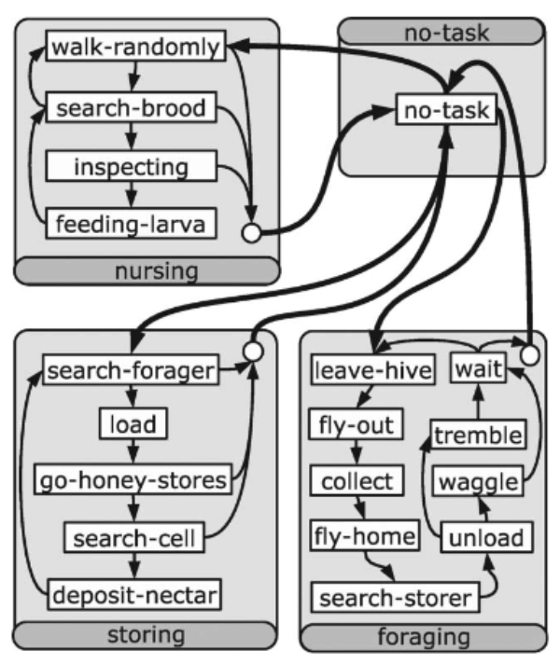
Modelling Division of Labour
Each type of local stimulus can motivate an unemployed adult bee agent (task= ’no-task’) to join one of the tasks m ∈ { ’foraging’, ’storing’, ’nursing’ }. See the previous figure (upper part) for the possible task transitions. Whenever one of these stimuli exceeds an individual threshold of an agent i located on that patch x, the agent engages in the associated task m.
Employed bees may switch back to the unemployed state, but for allow specialization within the system, the threshold levels for each agent is adapted during runtime to avoid bees to change state continuously.

Slide 11
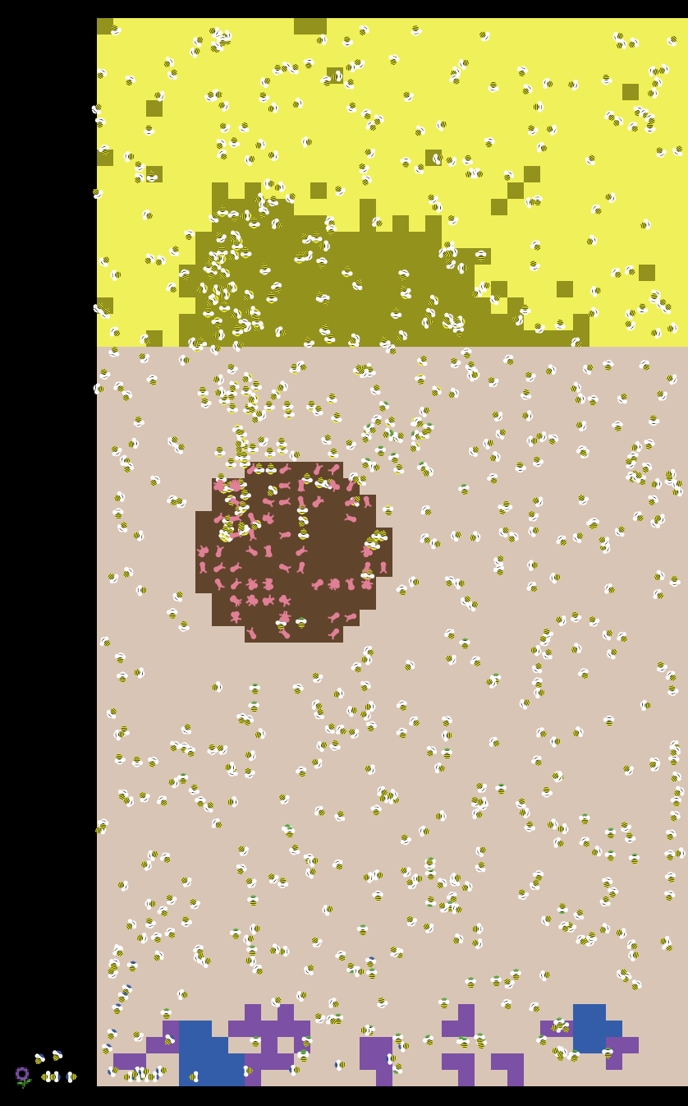
Simulation
Initial conditions:
700 adults bees
100 larvae
The larvae were distributed randomly around the center of the hive. All adults agents started in randomized positions.
The agents will show a self-organization propension and aggregate/distribute in similar patterns.

Slide 12
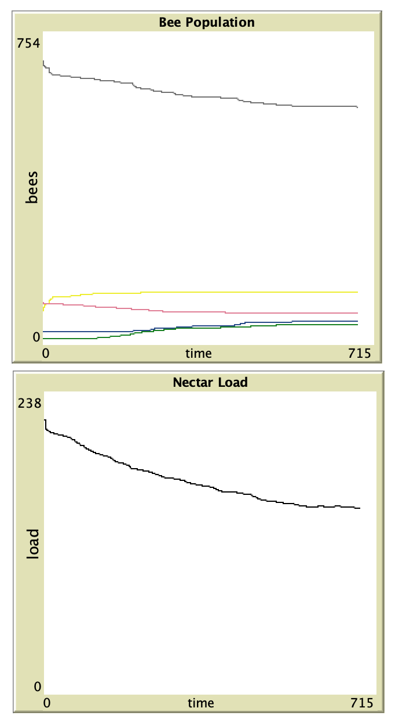
Plots:
We can observe the bee population over time and the total nectar load in the top hive area (nectar storage area).
In the initial time steps, some larvae die due to the absence of nurse bees. However, after a few time steps, the larvae emit hunger stimuli, prompting some bees to switch from a "no-task" state to the "nurse" role, leading to system convergence.
Similarly, the nectar load decreases during the first time steps because there are no bees assigned to storage tasks.

Slide 13
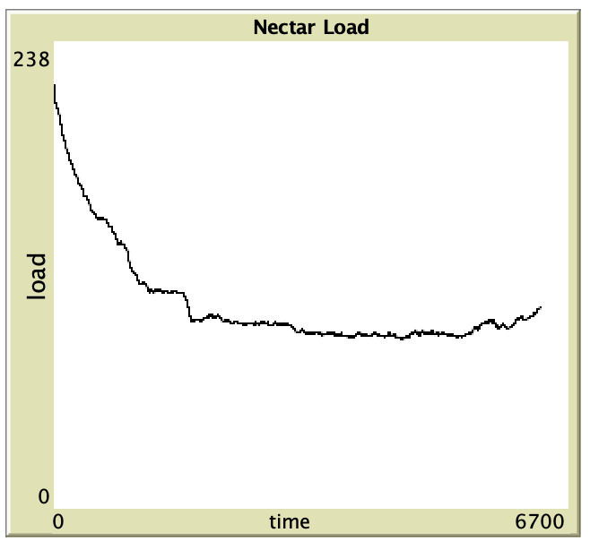
After ~ 7000 steps, we can see that the nectar load starts to increase.

Slide 14
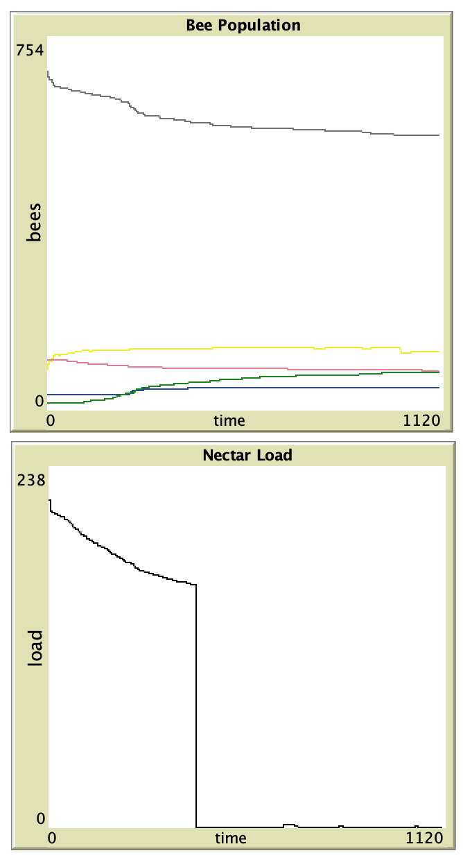
Perturbation:
We can perturb the system by removing all the nectar from the storage area.
As shown in the plots, the system is resilient enough to recover, thanks to the presence of a sufficient number of storer bees. It continues to function with minimal losses, particularly among the larvae.

Slide 15
This perturbation, which removes all the nectar from the storage area, reveals interesting results regarding the swarm's self-organization and adaptive capabilities.
When the storage area is empty, the bees adapt by increasing the number of storer bees, thereby boosting nectar collection and restoring the system's balance.

Slide 16
Thanks for the attention!

